Slide 1
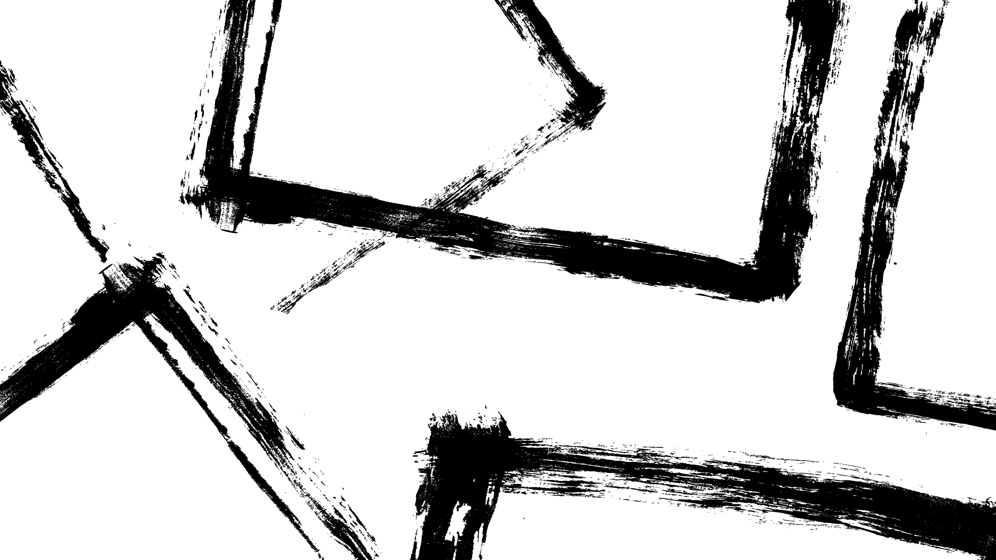
Object Motion Forecasting with Object Tracking and Trajectory Prediction Techniques
Utku Acar
CS523.V: Computer Vision
Ozyegin University
Vestel Electronics
Manisa, Turkey
utku.acar@ozu.edu.tr

Slide 2
What is the goal of the project?
Predict the object motions in real time.

Slide 3

How the project accomplish this goal?
Using various methods of the Computer Vision.
The mentioned methods are given below in the order of application:
Object Detection
Feature Extraction
Determine Region of Interest (ROI)
Object Tracking
Motion Prediction

Slide 4
Object Detection
There are two different cases for detecting objects:
Deep Neural Network Based Detection(cv2.dnn)
Pretrained weights are used for standard objects.
Computational Complexity is high.
Uses Blob-like image patches with fixed sizes.
Uses BGR(Blue-Green-Red) images.
Should be optimized for different use cases.
Haar Cascade Classification Based Detection
Pretrained data has been used for frontal human faces.
Computational complexity is lower than DNN based approach.
Patch based searching has been used.
Uses Gray-Scaled images.

Slide 5

Feature Extraction
Converting images to Gray-Scale
For each object get the corner points.
Create a Region of Interest by using those corner points (Rectangle)
Resize ROI to make the computations consistently.
Compute Histogram of Gradients with using ROI.
Append the result to the features.

Slide 6
Determining Region of Interest (ROI)
There are two options for determining the initial ROI:
Manual ROI Selection: User choose the object from the pop-up window.
Auto ROI Selection: The ROI has been determined by the model itself (YOLOv4- Haar). Which is determined as first / main object.

Slide 7

Object Tracking
Create
Create an Object tracker which is based on CSRT (Channel and Spatial Reliability Tracker)
Initialize
Initialize tracker via the first frame and first bounding box.
Update
For each consecutive frame update the tracker via giving the current frame.
Draw
Draw the Green Rectangle around the object.

Slide 8
Motion Prediction
Calculate displacement using corner point differences between previous and current bounding box.
Divide displacement to time difference between consecutive frames to get velocity.
Predict the objects motion at the next frame by adding the velocity times time difference to the corners of the current frame (assumption of constant motion).

Slide 9
Related Work: On Human Motion Prediction Using Recurrent Neural Networks
Previous studies on human motion modeling using deep RNNs have overlooked the task of short-term motion prediction. Martinez et al. (2017) have demonstrated that a simple zero-velocity prediction baseline outperforms the state-of the-art methods. To address this gap, they propose a sequence-to-sequence architecture with residual connections that surpasses previous approaches when trained on sample-based loss. Their architecture is straightforward and scalable, making it suitable for training on large-scale human motion datasets, which we found crucial for capturing short-term dynamics. While providing high-level supervision improves performance, their unsupervised baseline remains highly competitive. This departure from previous work typically focused on small action-specific datasets, is promising. Future research can explore leveraging even larger motion capture datasets in an unsupervised manner.

Slide 10
Related Work: Trajectory Prediction Based on Social Interaction
Alahi et al. (2016) proposed the ”Social” LSTM, an LSTM-based model that predicts human trajectories by jointly reasoning across multiple individuals in a scene. Each trajectory is modeled by a separate LSTM, and information is shared among them through a novel Social pooling layer. The proposed method outperforms existing approaches on publicly available datasets and successfully captures non-linear behaviors resulting from social interactions. Future work aims to extend the model to multi-class settings, where different objects share the same space, and to incorporate human-space interactions by including local static-scene images as additional inputs to the LSTM.

Slide 11
Related Work: PredRNN: A Recurrent Neural Network for Spatiotemporal Predictive Learning
PredRNN, introduced by Wang et al. (2021), is a recurrent network designed to capture spatial deformations and dynamics across frames. It uses a Spatiotemporal LSTM unit with hierarchical memory interactions to effectively represent different information levels. The unique memory flow, with separate pathways for horizontal and zigzag states, enables PredRNN to learn distributed representations for spatiotemporal variations. The authors propose to reverse scheduled sampling as a curriculum learning strategy to improve encoding and learn temporal dynamics from longer context frames. Experimental results demonstrate PredRNN’s state-of-the-art performance on various spatiotemporal datasets, including action-free and action-conditioned scenarios.

Slide 12
Related Work
These works use Neural networks intensely and model architectures are much more complex compared to mine. They also aim to predict human motions in more crowded scenarios. I only use position and motion parameters due to the previous frame and time while Wang et al. are using multiple spatial parameters for similar operations and, they use zigzag memory flow and customized LSTM which makes it superior to my project. I’m also using pre-trained models due to the computational requirements of the model and limited time while they are training their models according to the specific goal continuously.

Slide 13
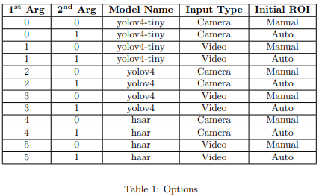
Options

Slide 14
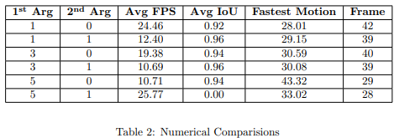
Numerical Comparisons

Slide 15
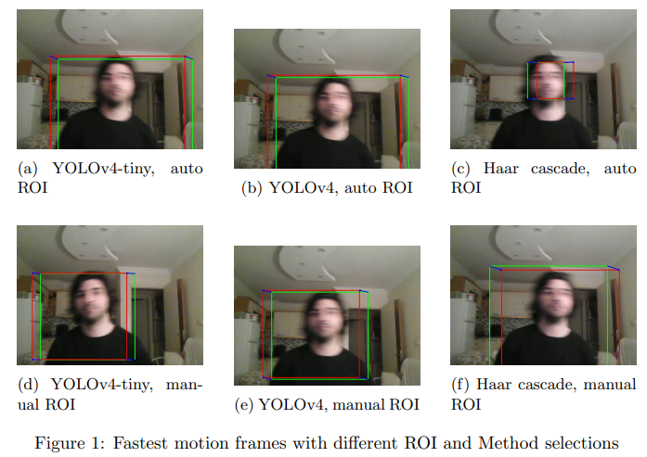
Fastest Frames

Slide 16
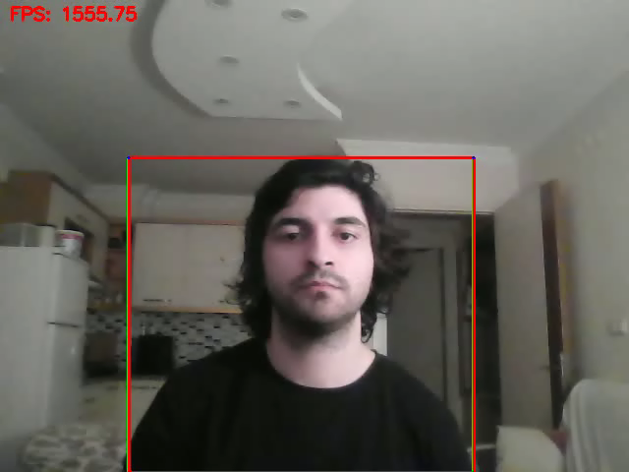
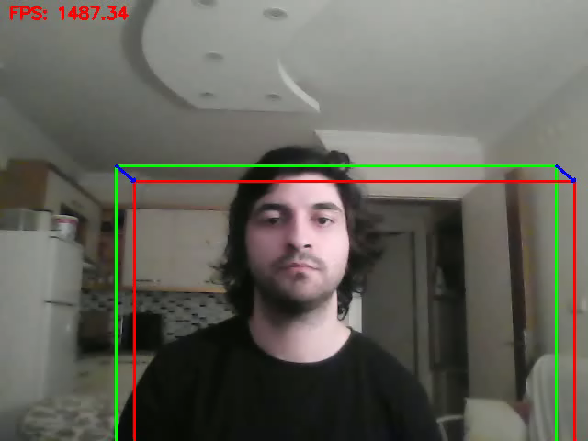
Yolov4-tiny Model Manual ROI
Yolov4-tiny Model
Auto ROI

Slide 17
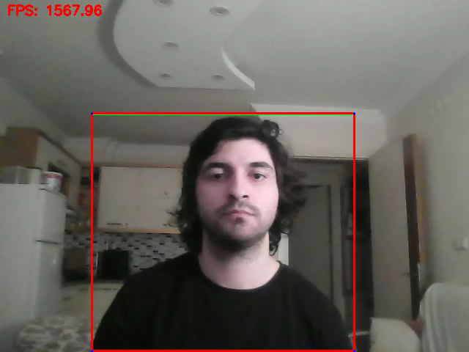

Yolov4 Model Manual ROI
Yolov4 Model
Auto ROI

Slide 18

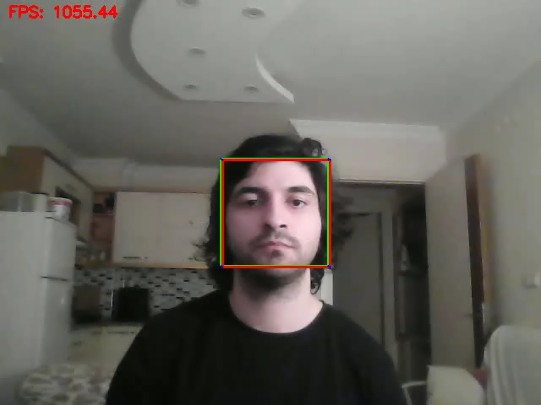
Haar Cascade Model Manual ROI
Haar Cascade Model
Auto ROI

Slide 19
Conclusions & Future Work
The project has successfully achieved its goal of predicting object motion by implementing state-of-the-art methods and techniques.
The higher Intersection over Union (IoU) values obtained indicate that the motion prediction accurately aligns with ground truth data, demonstrating the effectiveness of the implemented approach.
It is essential to note that the performance outcomes of object detection can vary significantly based on the chosen method or algorithm.
The project's results highlight the importance of carefully selecting the appropriate object detection method to achieve optimal performance in terms of accuracy and IoU scores.
Future work could involve exploring and comparing additional object detection methods to further improve the accuracy and robustness of motion prediction.

